Slide 1
Human Computer Interface

Slide 2
HCI and Designing the User Interface
The user interface is a critical part of an information system -- it is what the users see
A user's attitude towards a system can be coloured by their experience of the user interface
HCI combines techniques from psychology, ergonomics and computer science
HCI is about designing the inputs and outputs of a system taking into account human factors

Slide 3
What is the User Interface
Users of an information system need to interact with it by
- reading and interpreting information
- issuing commands to the system
- entering words and numbers
- reading and interpreting the results or output produced
- responding to and correcting errors
These are secondary tasks as opposed to the user's primary objectives
- a well-designed system means the secondary
tasks will be easy to carry out

Slide 4
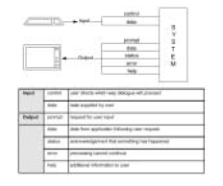
Two Metaphors: The dialogue metaphor

Slide 5
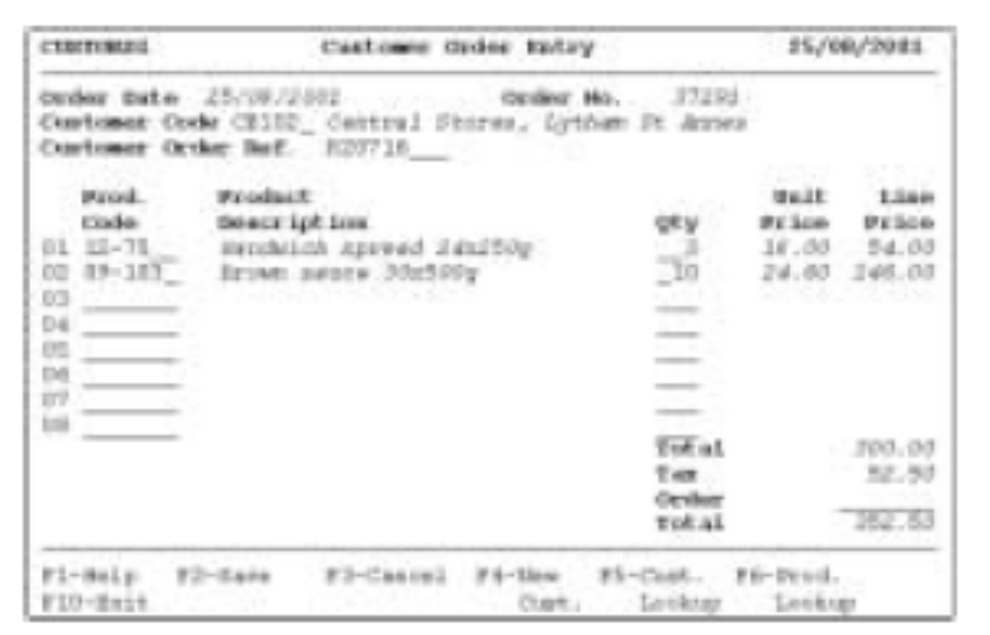
Example: order entry screen

Slide 6
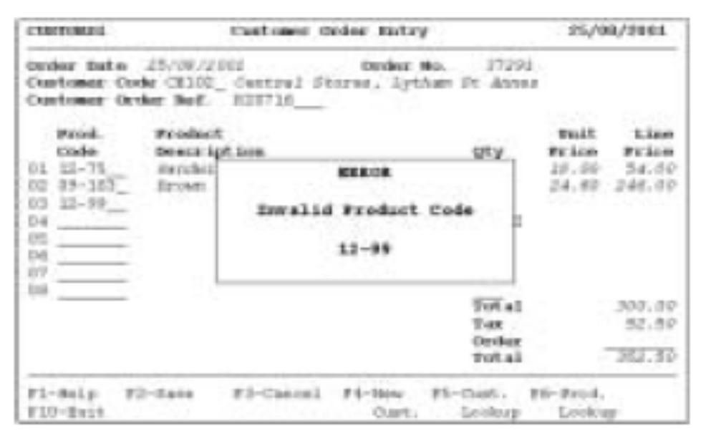
Example: order entry screen

Slide 7
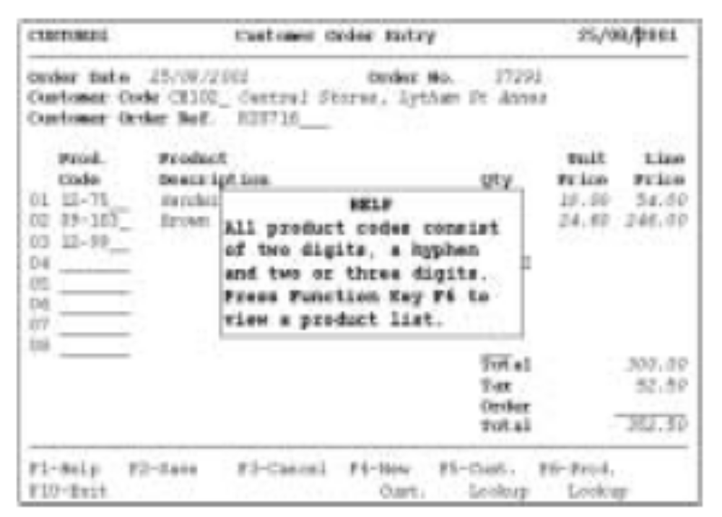
Example: order entry screen

Slide 8
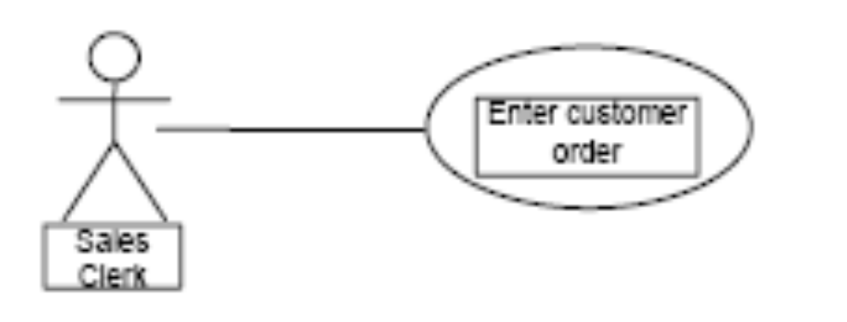
Use case Diagrams
Use cases may be used to document the dialogue between a user and the system
- e.g. Enter Customer code or look up customer in an index. For each line of the order, enter the product number and quantity. calculate the Line Price, Tax and totals automatically.

Slide 9
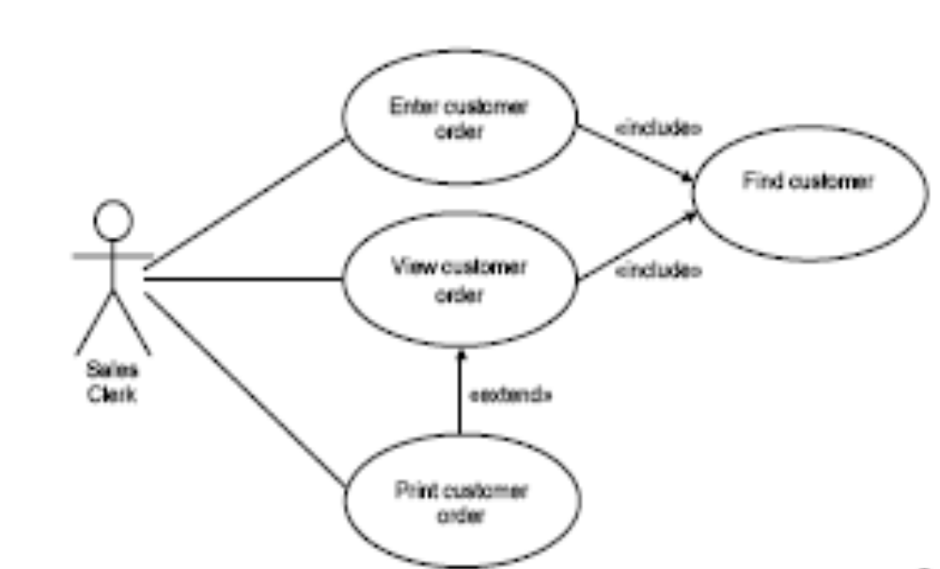
Use Case Documenting Dialogue

Slide 10
Two metaphors: The Direct Manipulation Metaphor
The interface gives the impression that you are manipulating objects on the screen through the use of the mouse
- drag and drop an icon
- shrink or expand a window
- push a button
- pull down a menu
Such interfaces are event-driven
- the window manager responds to events
and changes the state of the objects in the
window

Slide 11
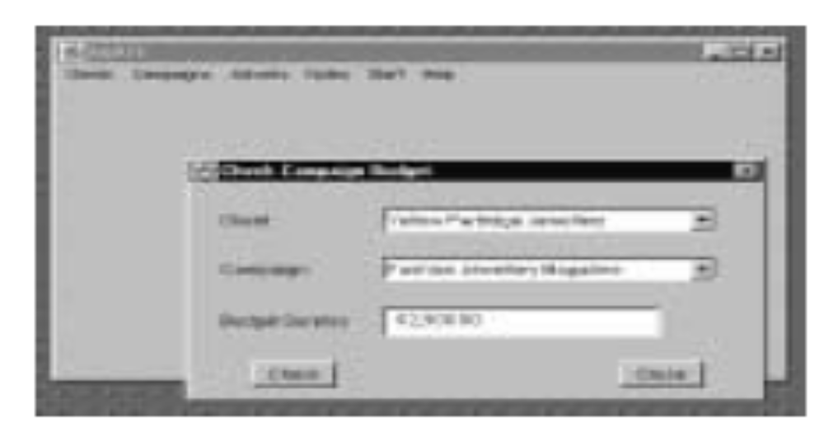
Interface for the Use Case Check Campaign Budget

Slide 12
Characteristics of Good Dialogues (1)
Consistency
- a consistent user interface design helps users to learn an
application and to apply what they know in different parts of the
application
Appropriate user support
- when the user does not know what action to take or has made an error
- help messages
-- should be context sensitive
-- may be general or specific
-- provide links between different levels of help
-- separate screens, status line or tooltips

Slide 13
Characteristics of Good Dialogues (2)
Appropriate user support
- error messages
-- should be informative (i.e. explain what has gone wrong
and how the user can recover)
- warning messages
-- can prevent the user from making serious errors
Adequate feedback from the system
- users expect the system to respond once they have carried out
some action
- the system's response time should be appropriate to the type of
user action
- the user should be able to cancel commands

Slide 14
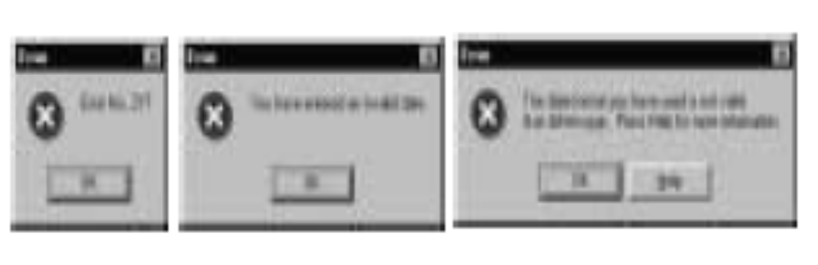
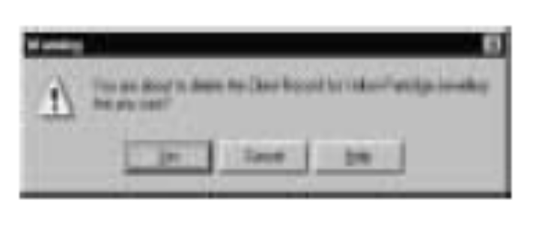
Error and Warning Messages

Slide 15
Characteristics of Good Dialogues (3)
Minimal user input
- reduce unnecessary input from the user
- use codes and abbreviations
- select from a list
- edit incorrect values or commands
- prevent information from being re-entered if it can be derived
- use default values
- provide shortcuts, key combinations for advanced users

Slide 16
Style Guides
Some organisations provide standard guidelines or style guides for the design of user interfaces
- The Windows Interface Guidelines for Software
Design (1997)
- Macintosh Human Interface Guidelines (1996)
- large organisations produce their own style guides
A consistent style enables users to quickly become familiar with new applications

Slide 17
Approaches to Interface Design
There are many different ways of designing and implementing a user interface
Design is influenced by
- the nature of the task the user is carrying out
- the type of user
- the amount of training undertaken by the user
- the frequency of use
- the hardware and software architecture of the
system

Slide 18
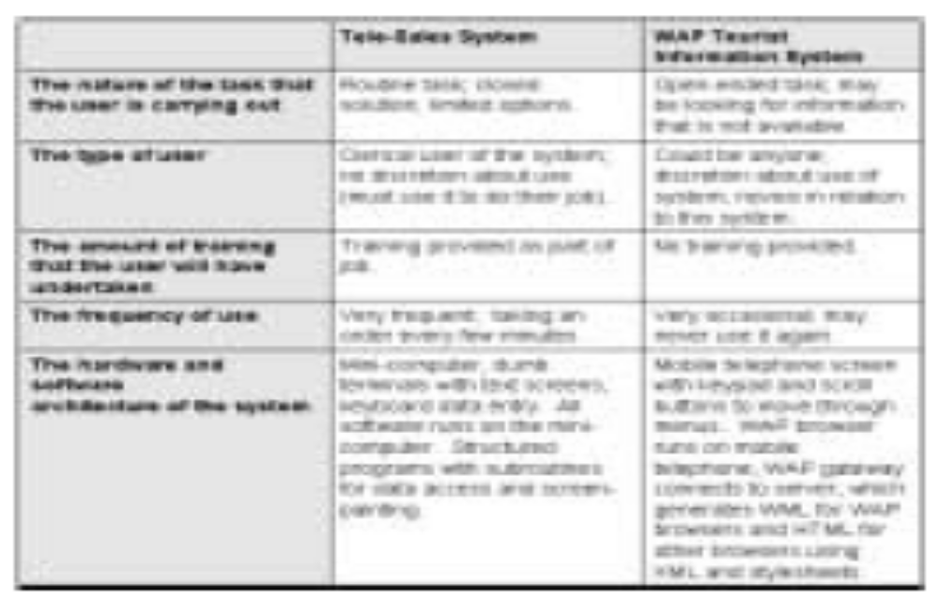

Slide 19
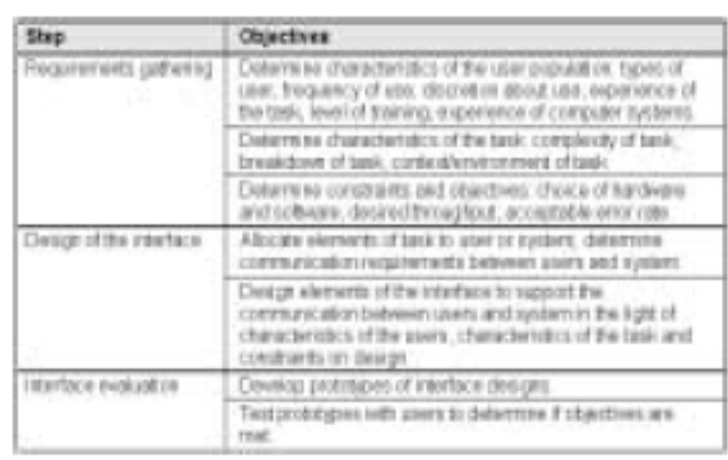
Steps and Objectives in HCI Design

Slide 20
Scenario-based Approach
A scenario is a step-by-step description of a user's actions
- used as tool in requirements gathering,
interface design and evaluation
- can be a textual narrative describing a user's
actions
- storyboards (series of pictures that depict actions)
- video mock-ups
- prototypes
Use cases are similar to scenarios

Slide 21
Examples of Scenario
Pete starts up the word-processor.
He types in a title for the note and changes its style to Title.
He types in two paragraphs describing his idea for an advertisement for the Yellow Partridge campaign to be used in fashion magazines in Europe during the summer of 1999.
He types his initials and the date and time.
He uses the short-cut keys to save the file.
The save-as dialogue box appears and, using the mouse, he changes to the Summer 1999 Campaign folder in the Yellow Partridge folder on the server.
He scrolls to the bottom of the list of files already in the folder and reads the title of the last note to be added, Note 17, he calls the new note Note 18 and clicks on Save.
He exits from the word-processor.

Slide 22
Roles for Scenario-based Approaches
Gather requirements
- describe what the user does now
Envision solutions
- describe possible ways of working
Evaluate systems
- write test cases that follow scenarios
Document the system
- write manual sections that follow scenarios

Slide 23
Scenario-based Design
Can result in large volumes of textual information
- requires document management
- may delay implementation
Solution
- use computer-based tools to develop and document scenarios and to develop working models of scenarios
- software implementation decisions may be documented at the same time

Slide 24
Achieving Usability
Learnability
- how much time and effort is required
Throughput
- speed with which a task can be accomplished and
the number of errors
Flexibility
- the ability of the system to handle changes to the
tasks that users carry out
Attitude

Slide 25
Summary
System designers must take account of the requirements of the people who use their software
- to reduce errors, and maximise user-satisfaction
The dialogue and direct manipulation metaphors
The scenario approach to interface design
References: Bennett et al, Chapter 16, Maciaszek, Chapter 6

